Slide 1

Classifying brands on Facebook using supervised machine learning
General Assembly DSI : Capstone Project
by Sam Ho
sam@samho.co.uk

Slide 2
Agenda
Findings EDA & Modelling
Data & Approach
Context
Goals
Round Up

Slide 3

CONTEXT

Slide 4
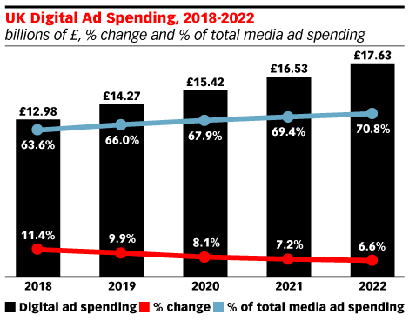
In 2018, almost two thirds of all advertising spend was on digital
https://www.emarketer.com/content/more-than-60-of-uk-media-ad-spending-is-digital
Notes:
Includes all formats – PPC, paid and social

Slide 5
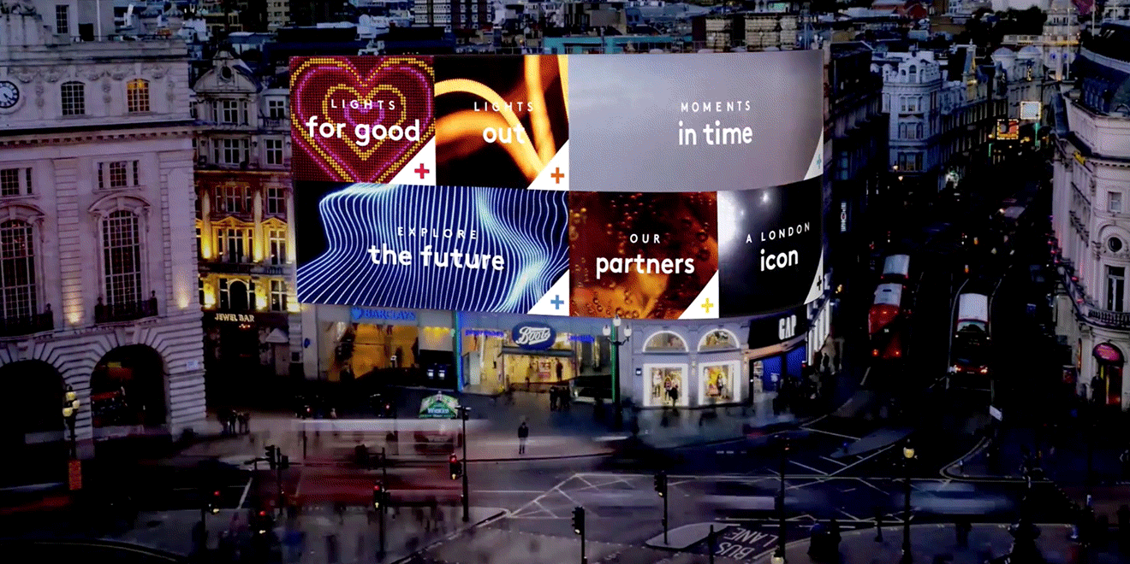
Why does this matter?
More spend =
…more content
…more noise
Increasing pressure to
…stand out
…to differentiate

Slide 6

What do we want to find out?
Are brands doing enough to ensure their Facebook content is different from their competitors?

Slide 7
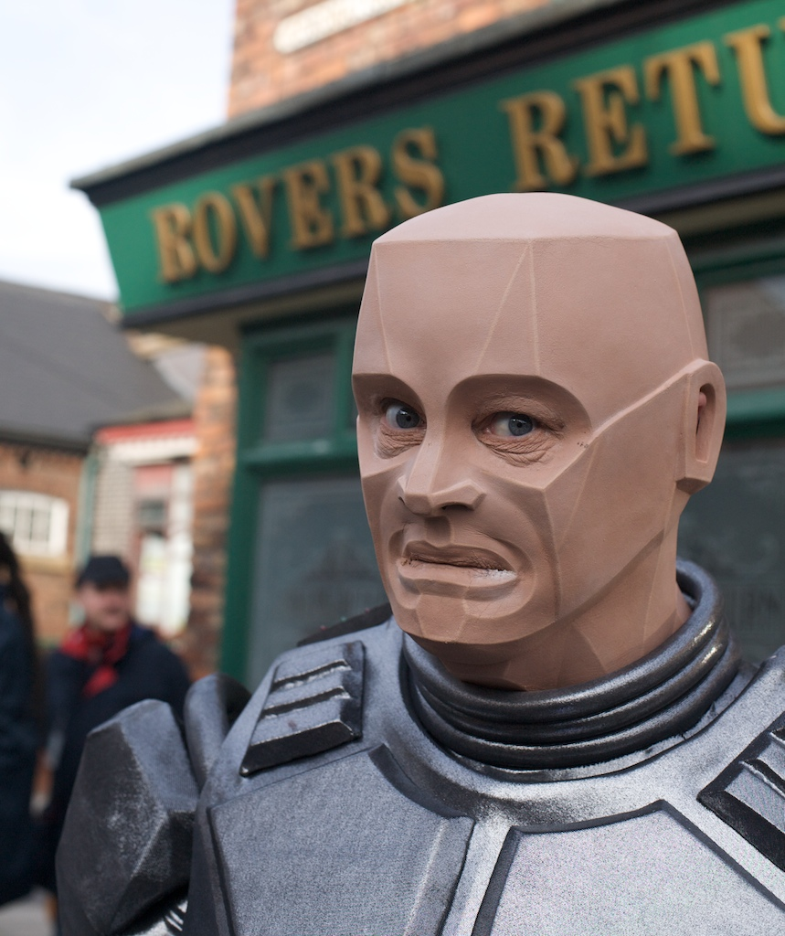
How do we use Data Science to answer this?
Can we make a robot smart enough to tell the difference between the brands speak on Facebook?
*Can we use supervised machine learning to help us classify different brand content on Facebook?

Slide 8
DATA & APPROACH

Slide 9







One category and its main brands
Higher End / Premium
Lower End / Budget
All on Facebook. All posting consistently. All with some purpose.

Slide 10


Data Streams & Feature Engineering
Primary
data stream & features
Secondary
data stream & features
Engineered
features
Selenium
Dashboard CSV output
Python / Pandas
Vectorised Post Content
Contains_Link
Contains_Video
Has_Hashtag
Hashtag_Count
Post Content
#Responses
#Comments
#Shares
#Video views
Response_Rate Comments_Rate
Shares_Rate
Video_Rate
# Page Likes
(by date)

Slide 11
Seven classes, largely balanced
6350 posts overall (spanning 2015-2018)
870 posts
(0.13)
777 posts
(0.12)
714 posts
(0.11)
1068 posts
(0.16)
770 posts
(0.12)
798 posts
(0.12)
1353 posts
(0.21)
Our baseline is 0.21 – our dominant class. If we can build a model that can score higher than this, then we can reject our null hypothesis and concede that there are genuine differences in the content produced by our brands

Slide 12
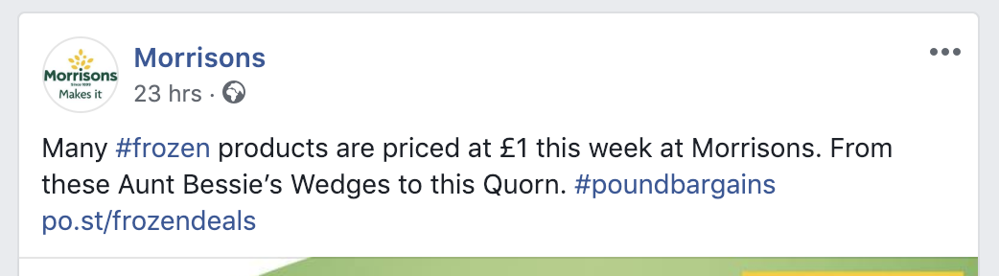
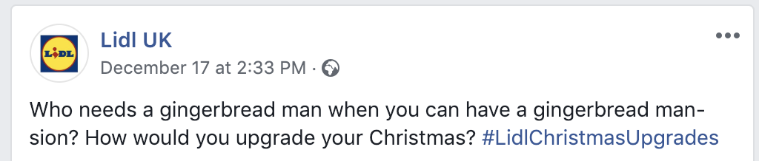
Data Prep & Cleaning
Extensive stop words & regex to clean data
Remove all ‘hard’ branding features i.e. ‘Morrisons’
Remove all ‘soft’ branding cues i.e.
#LidlChristmasUpgrades

Slide 13
FINDINGS
Exploratory Analysis

Slide 14
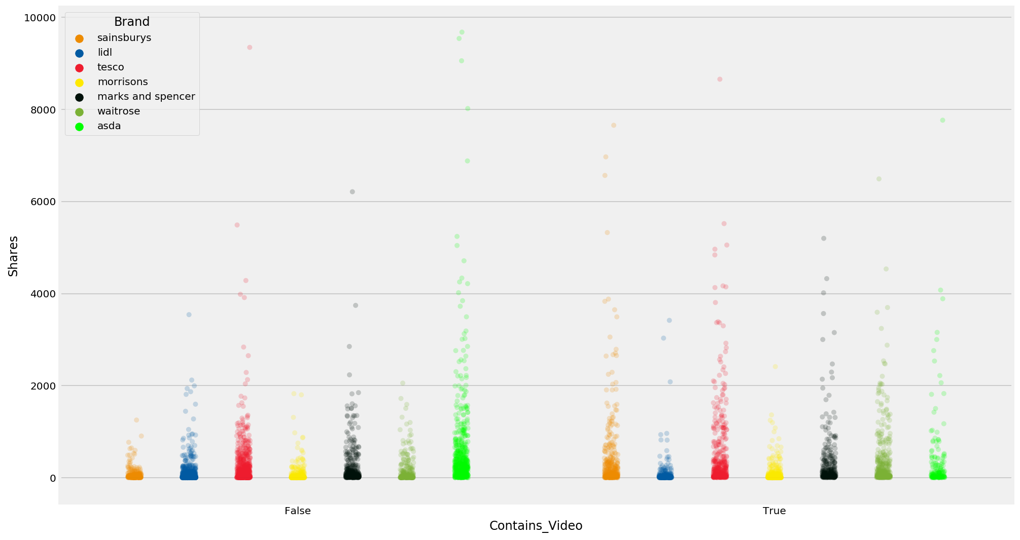
A first indication that content is likely different

Slide 15
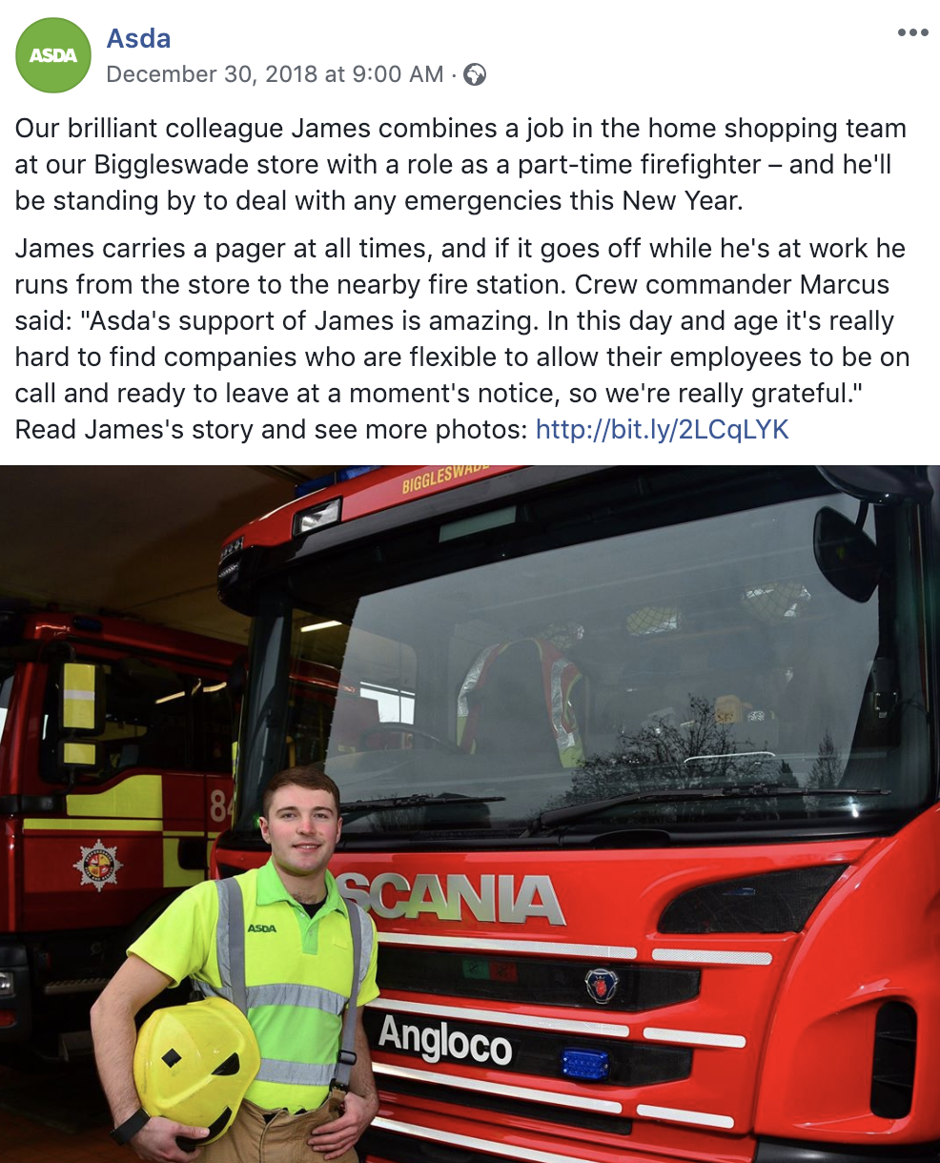
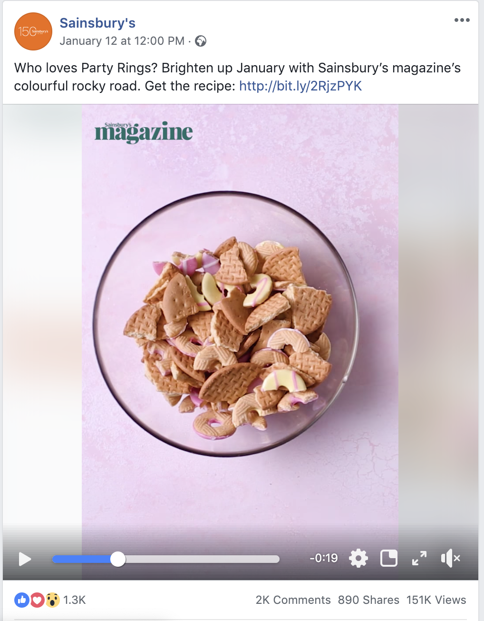
Qualitatively, it feels that there is a difference!

Slide 16
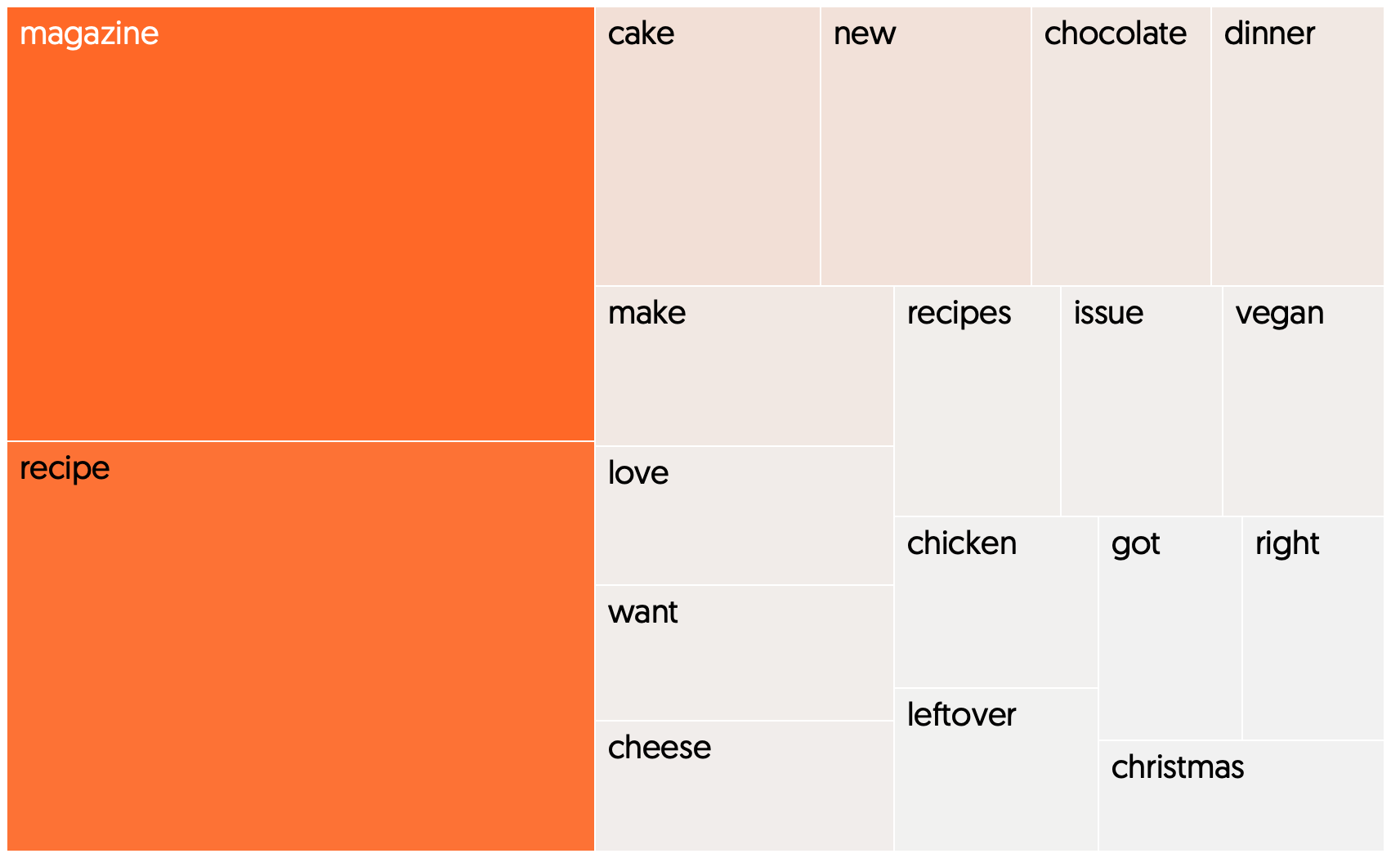
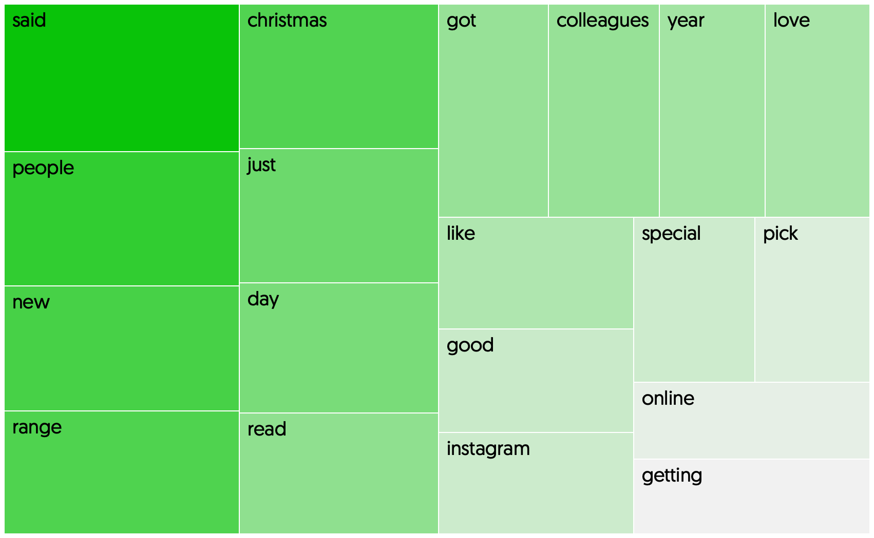
Sainsbury’s talk about their magazine/recipes......less so for ASDA
Weighted term frequencies by brand : (TF-IDF) Vectorisation

Slide 17
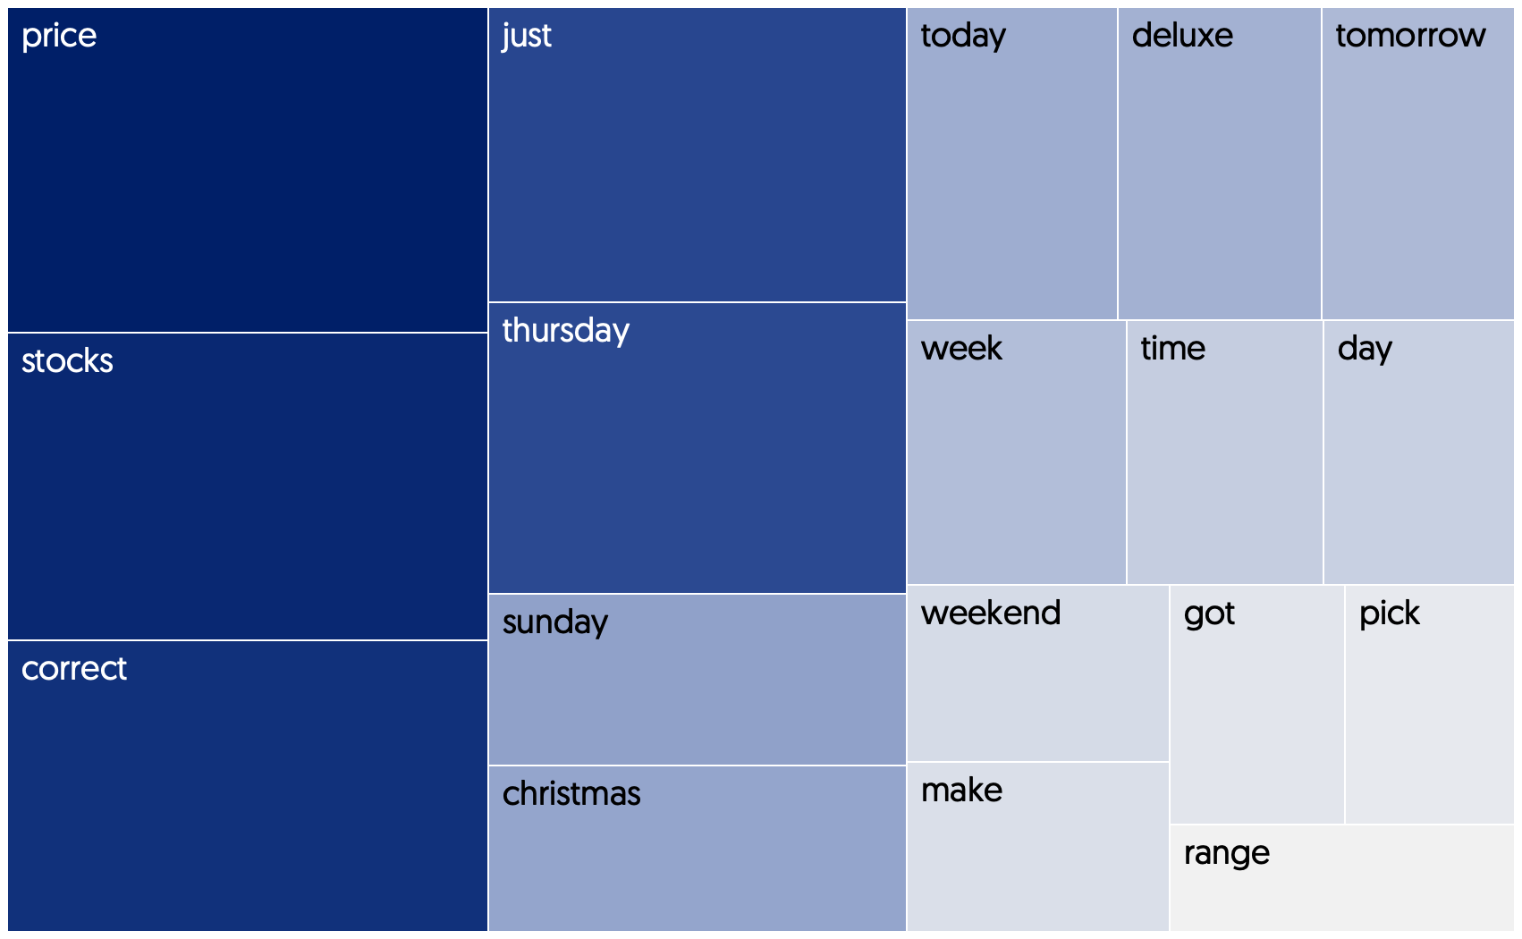
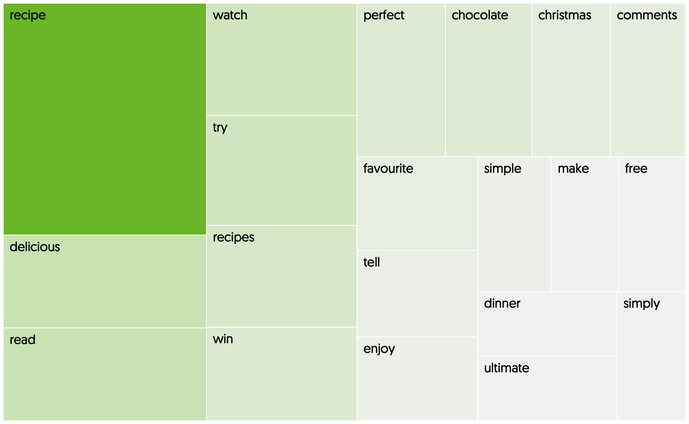
Lidl talk about price and stock availability whereas Waitrose focus on food
Weighted term frequencies by brand : (TF-IDF) Vectorisation

Slide 18
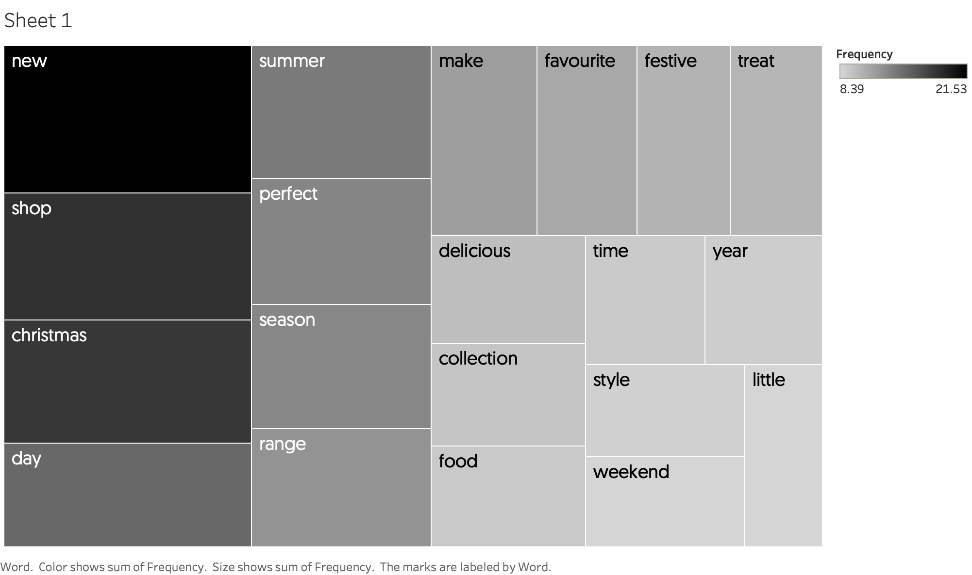
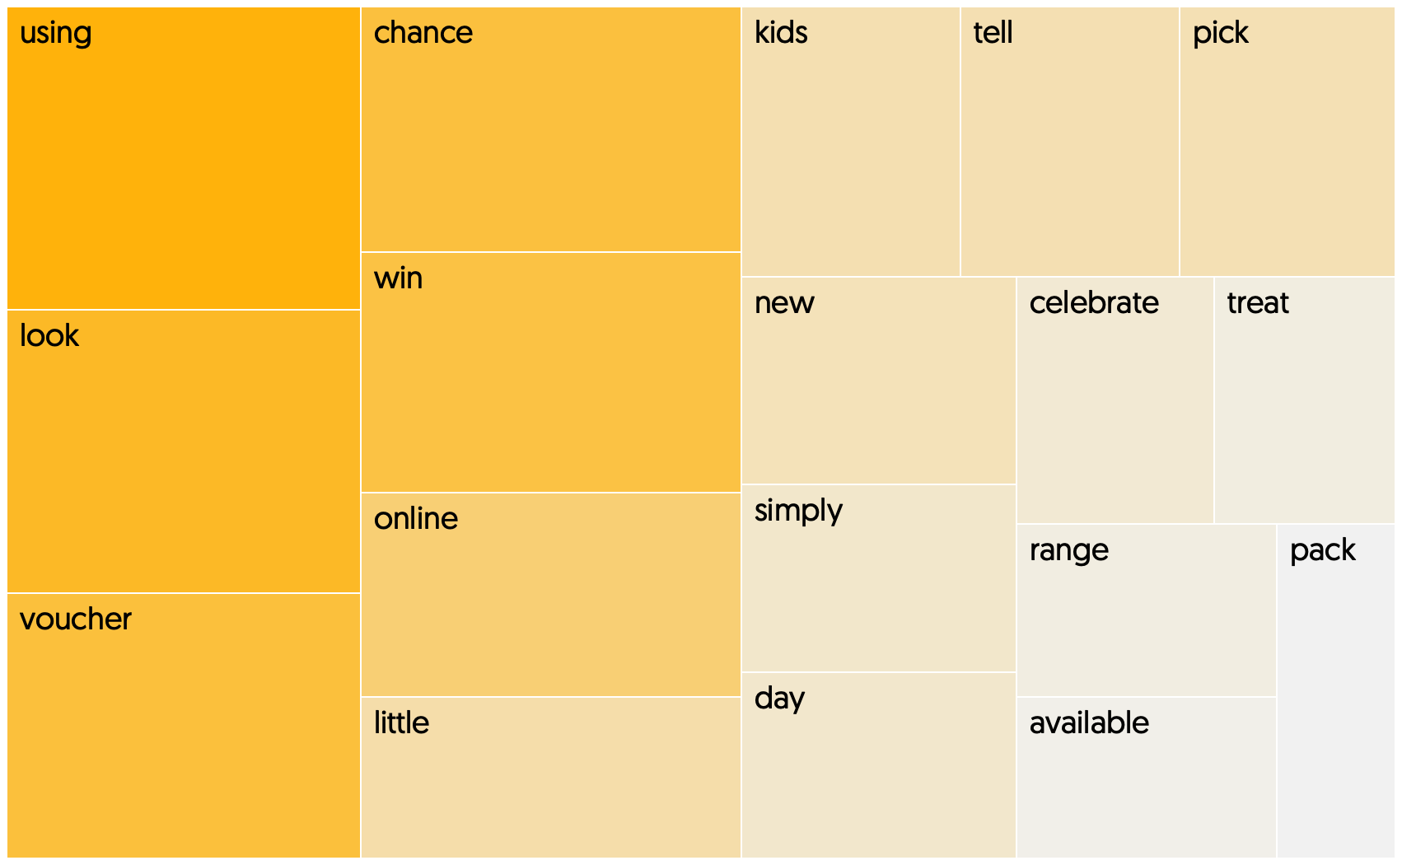
M&S talk about new things to shop for (other than food i.e, clothes), Morrisons, much like Asda, avoid talking about food
Weighted term frequencies by brand : (TF-IDF) Vectorisation

Slide 19
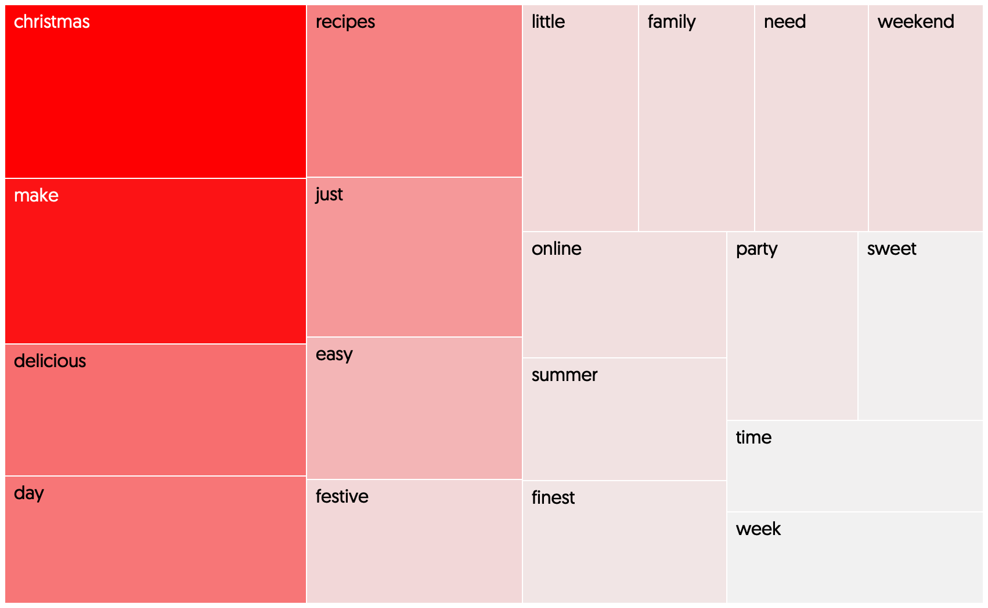
Tesco owns Christmas!
Weighted term frequencies by brand : (TF-IDF) Vectorisation

Slide 20
FINDINGS Modelling

Slide 21
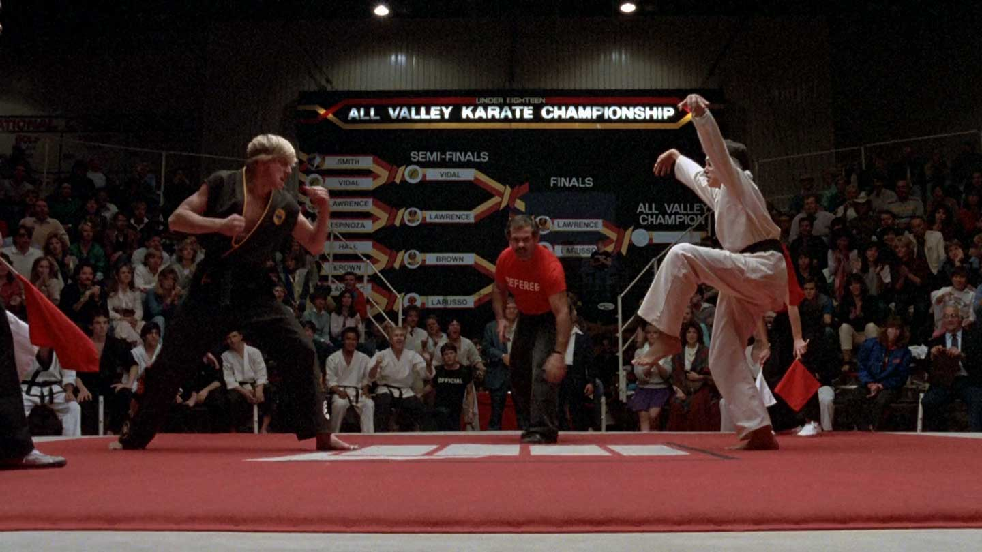
Modelling Approach
Performance Optimization
Performance Optimization
Round 1!
Round 2!
Finalist / Winner
Logistic Regression
(0.692)
KNN
(0.47)
Random Forest Classifier
(0.61)
SVM
(0.69)
Multi Layer Perceptron
(0.68)
Logistic Regression
KNN
Random Forest Classifier
SVM
Multi-Layer Perceptron
Grid Search with 5 fold
Cross Validation
Ensemble
Voting Classifier
‘Frankenstein’ Classifier
0.699
Metric : classifier accuracy score on
Test/unseen data

Slide 22
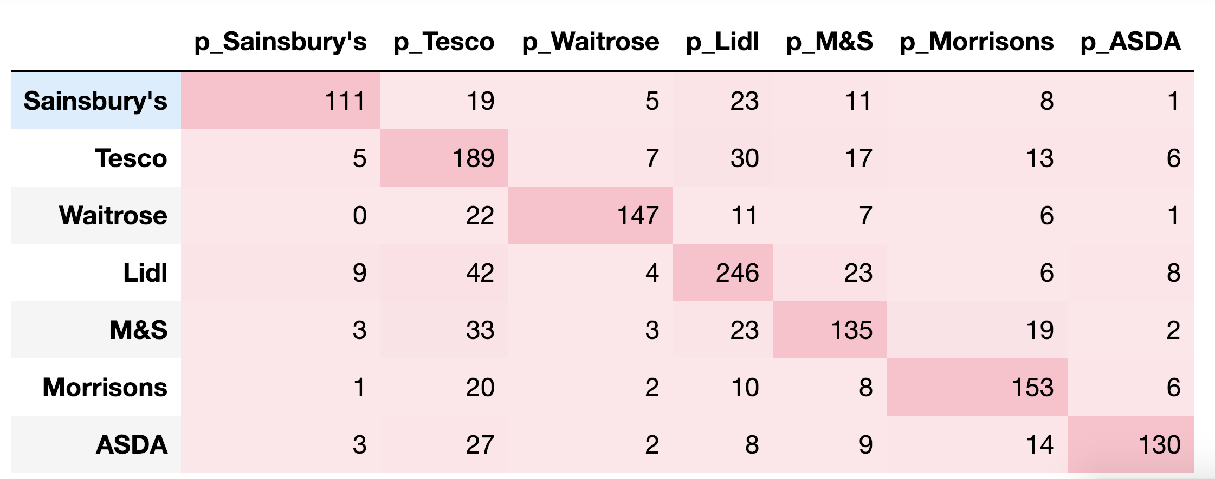
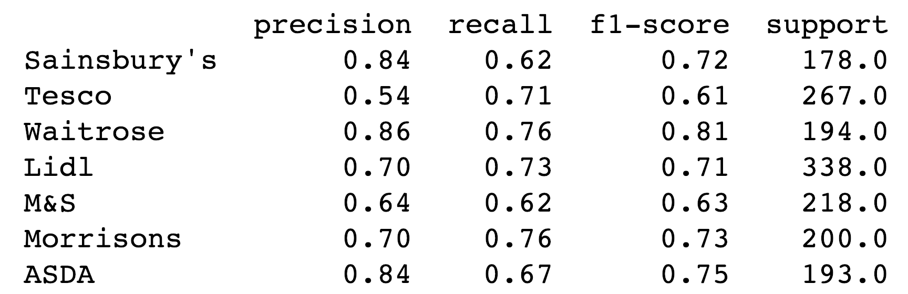
Classifier Evaluation
High precision with Waitrose, Sainsbury’s and ASDA

Slide 23
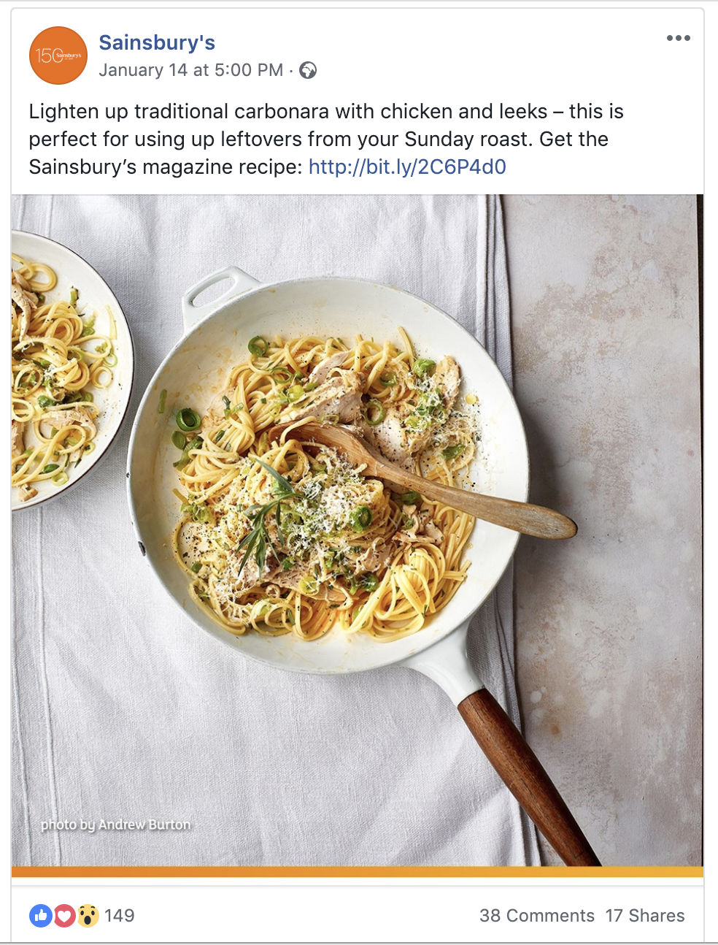
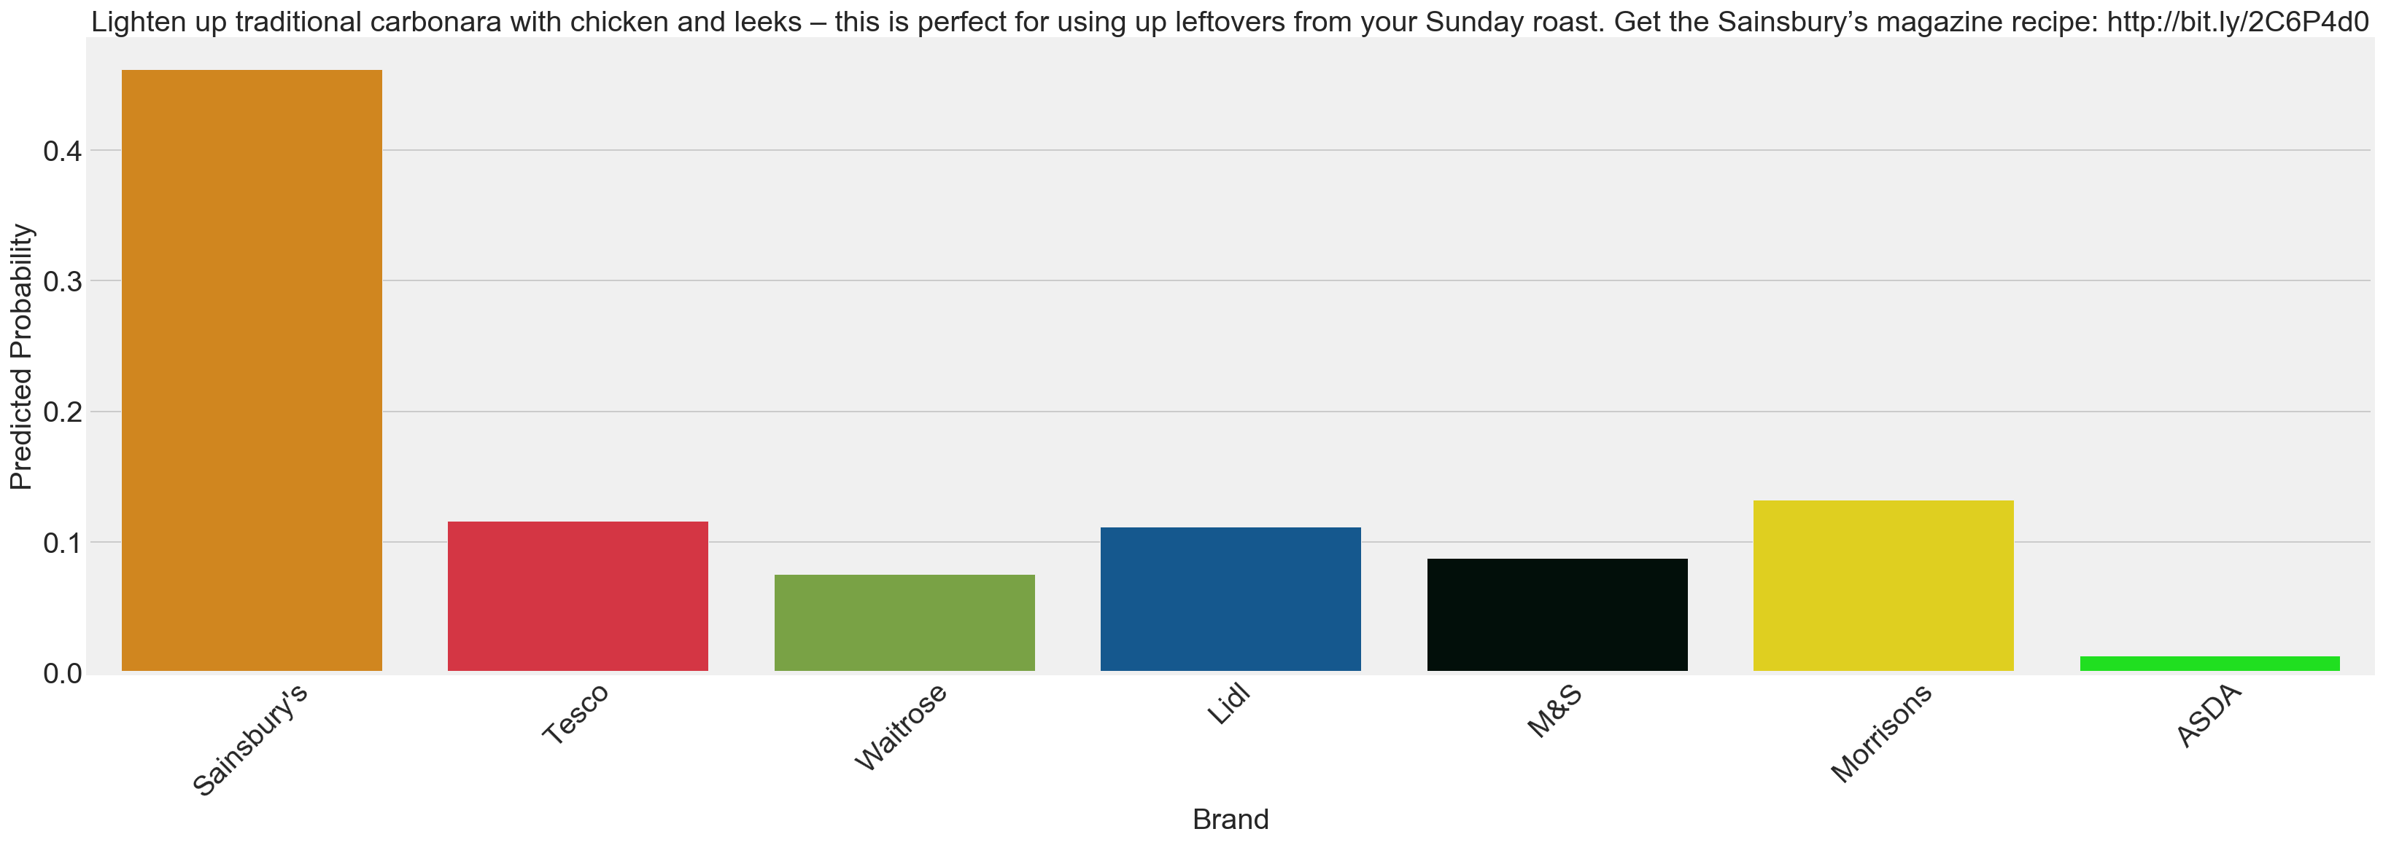

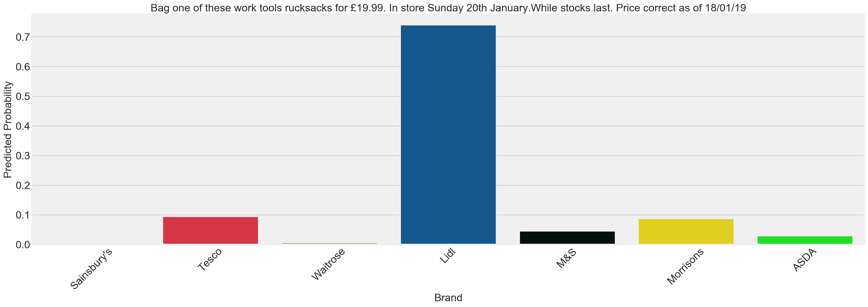
Testing the model on new data

Slide 24
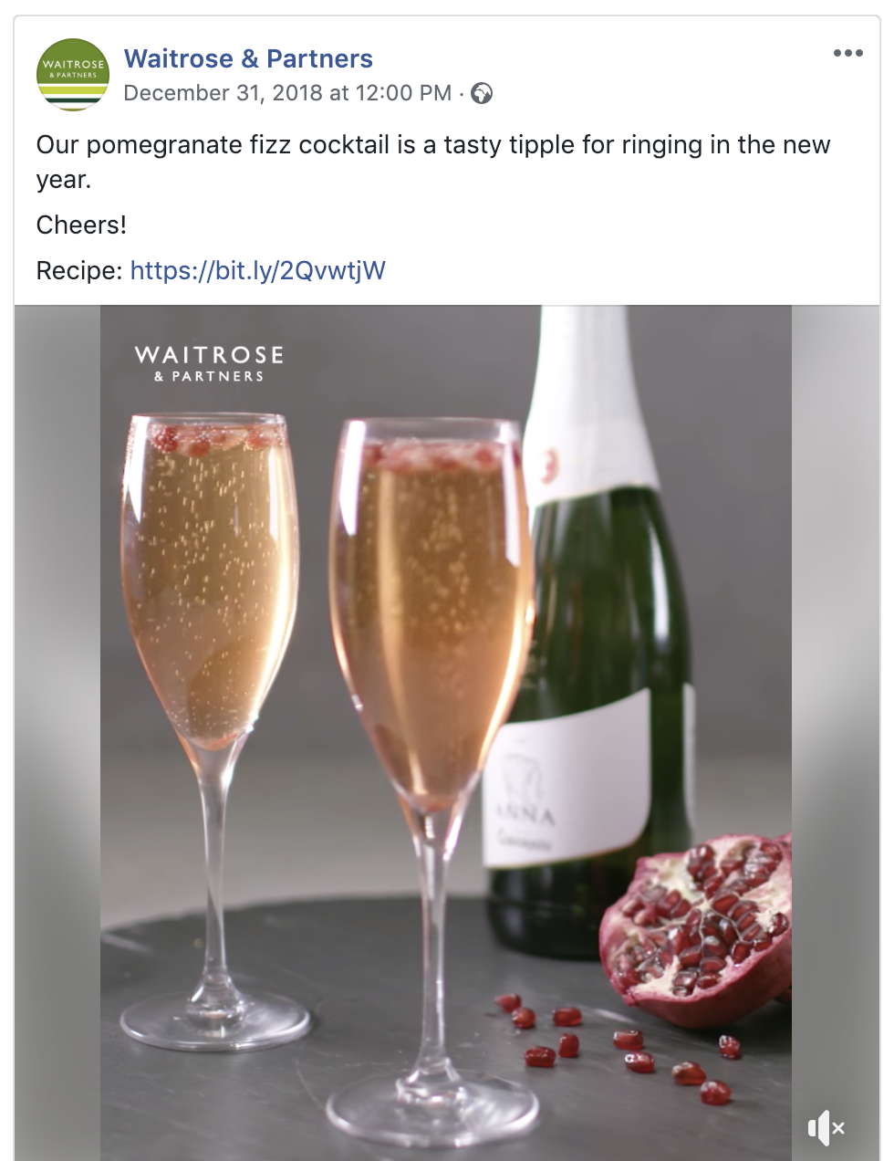
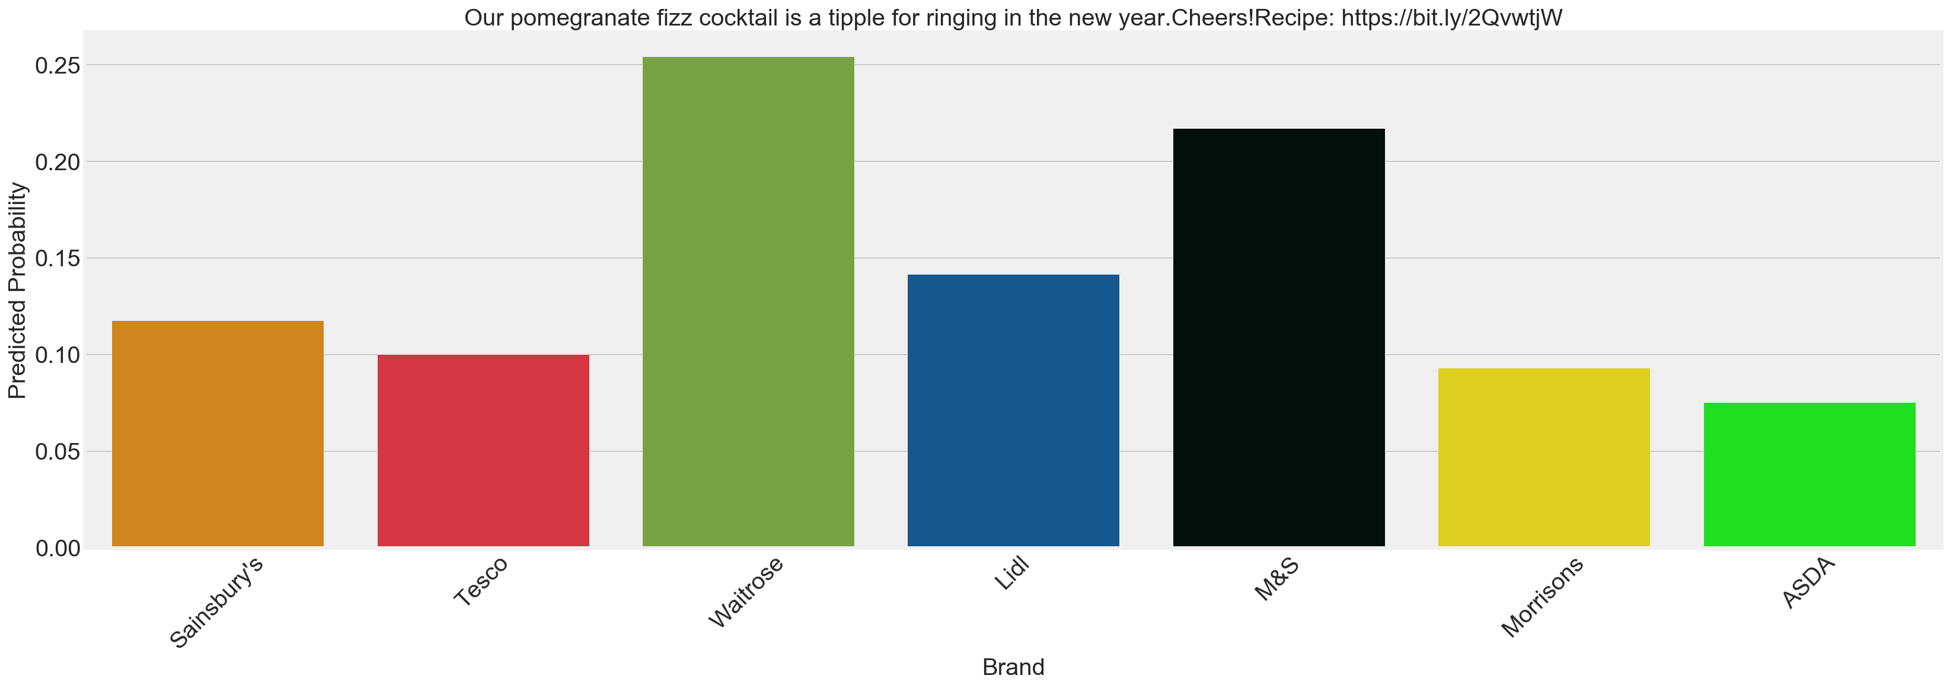
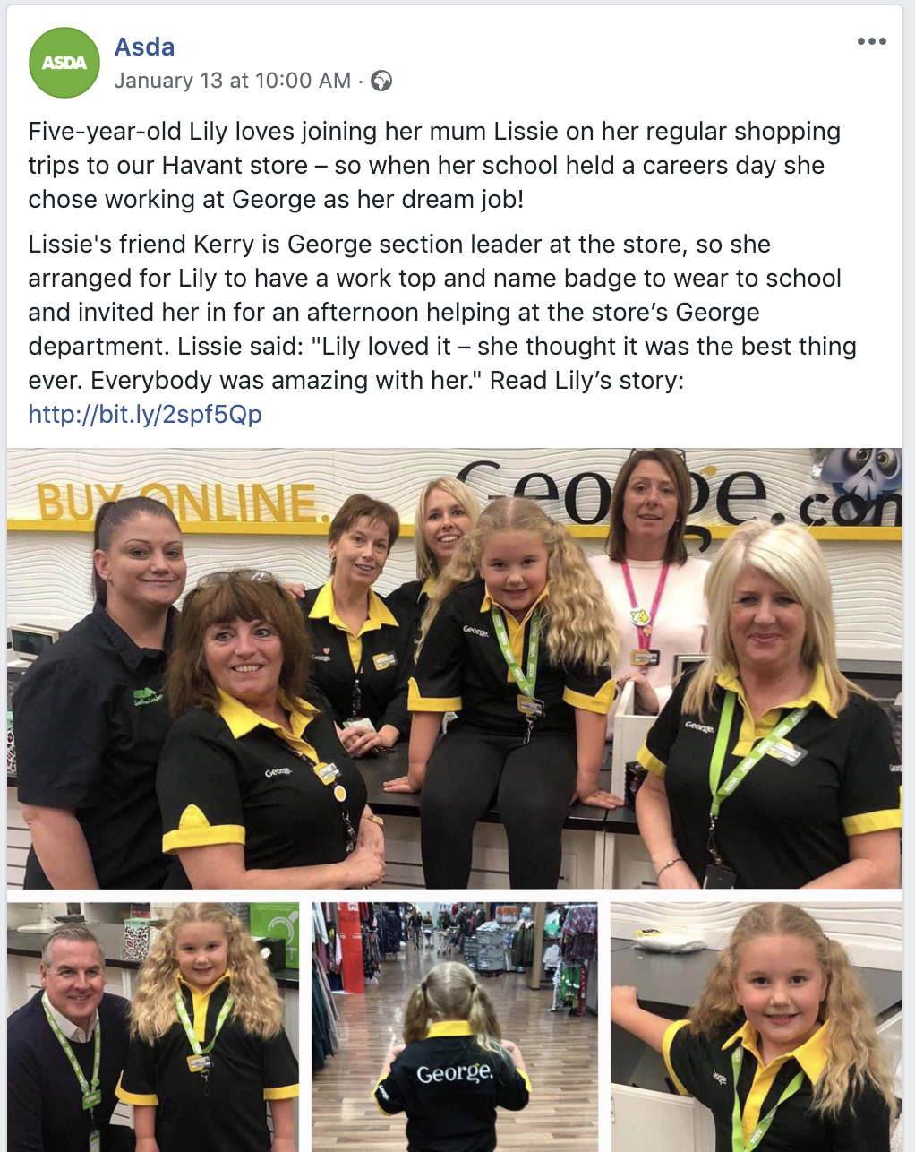
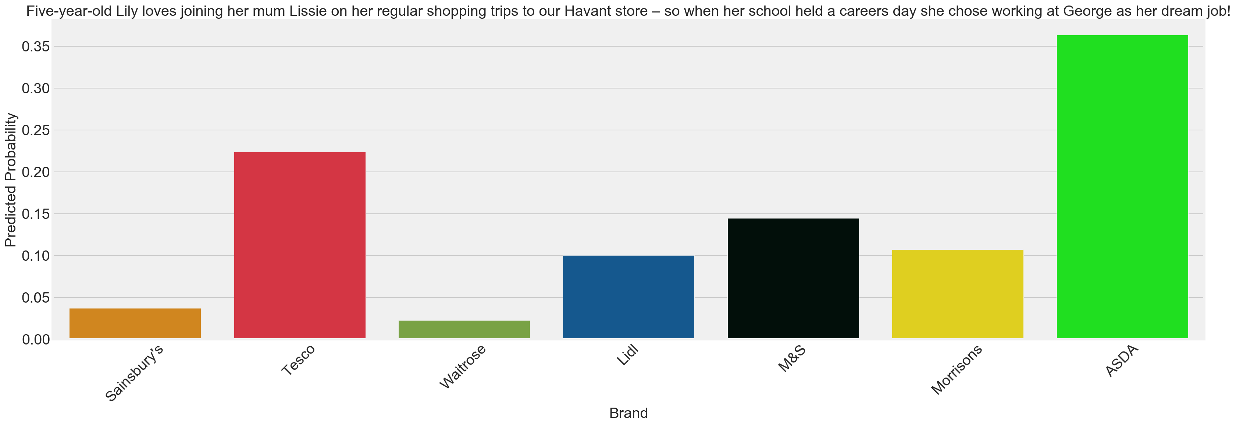
Testing the model on new data

Slide 25
ROUND UP

Slide 26
Potential Applications
Sense Checking!
You’re the social media manager at Waitrose.. ..your boss suggests posting about discounts and low prices..
Your model says don’t bother, this sounds like something like Lidl would post.
Your boss is super impressed. You get a raise.
Transferability to other categories
Facebook pages are all similarly structured in terms of their html It would be relatively easy to repeat this project with any other category on Facebook where brands are active e.g fashion brands

Slide 27

Risks & Limitations
It’s (not) been emotional
Word counts - even TF-IDF – don’t capture sentiment very well.
Future iterations of content analysis could look at sentiment and see if emotion is a useful predictor?
Neglected Features
Many features were acquired, that although were helpful for EDA, weren’t used in any modelling.
Could we look at regression models and see what kinds of content predict social ‘success’
Neglected Channels
There’s more to social media than Facebook.
Could we integrate data from Twitter, Instagram, Snapchat?

Slide 28
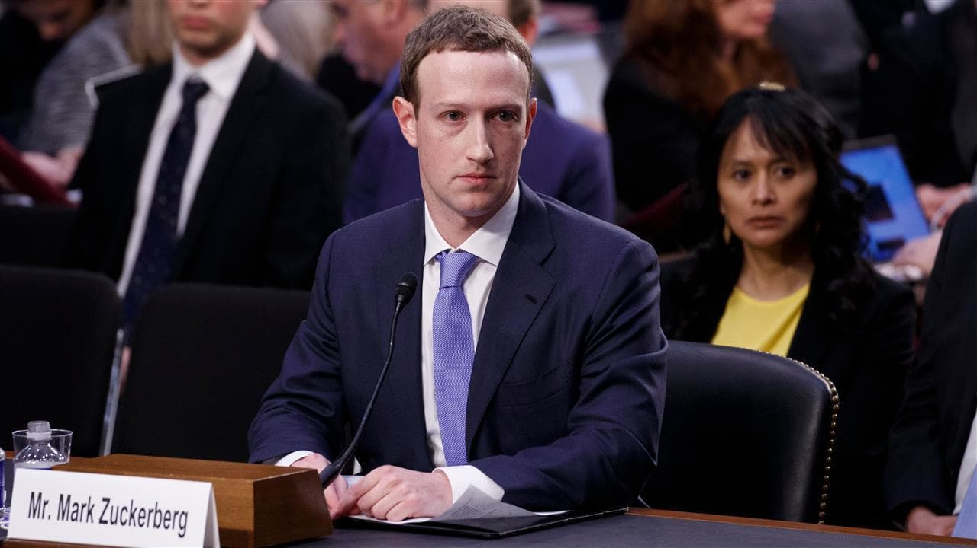
QUESTIONS?

